Slide 1
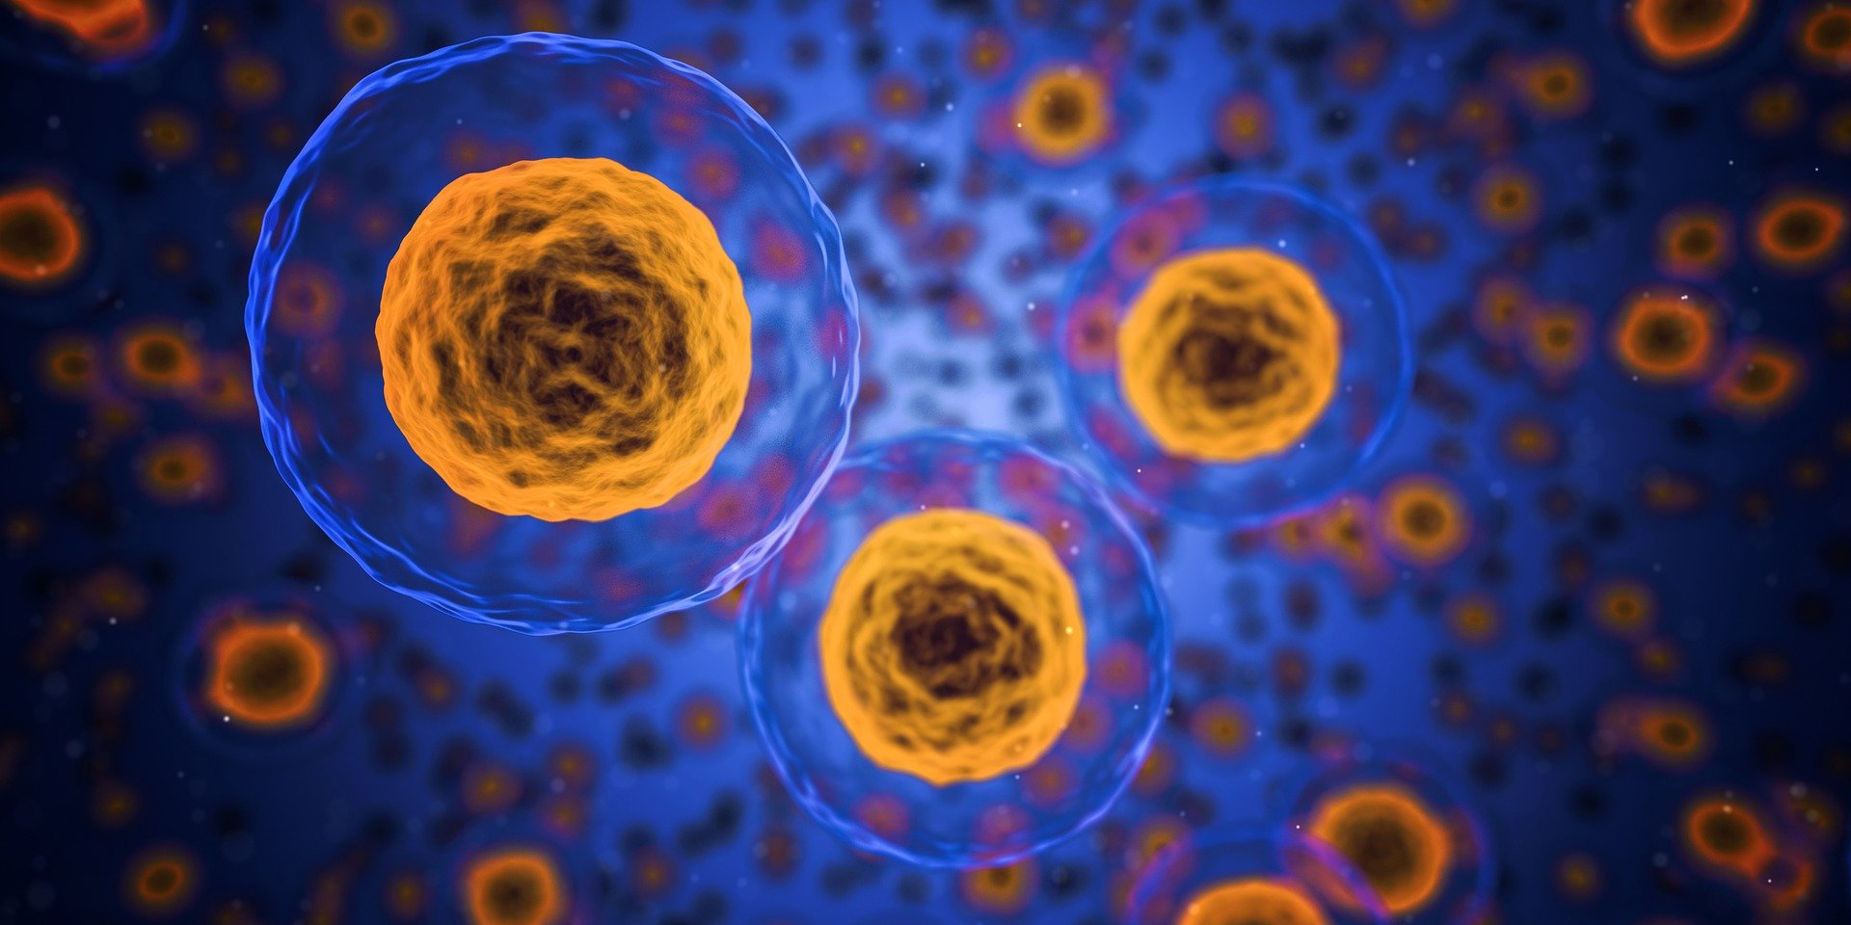
Chapter 1
Cell: the Unit of Life

Slide 2
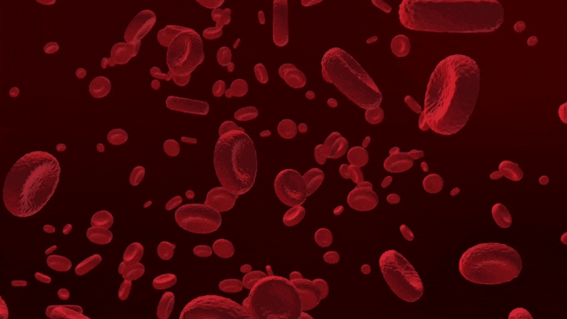
Existence of cells were not known until man invented microscopes.
Cell is the fundamental structural and functional unit of life.
Cells are so small that they cannot be seen with our naked eyes.
CELL
Every organ in our body and every part of a plant is composed of thousands of cells.
Old and weak cells die and are replaced by new cells.
Every cell has its own life. For e.g. RBC has a life span of 120 days.

Slide 3
CELL THEORY
The cell is the smallest structural unit of all living things.
The cell is the unit function of all living things.
All cell arise from pre-existing cells.

Slide 4
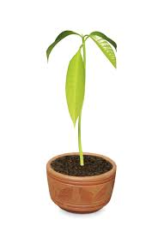
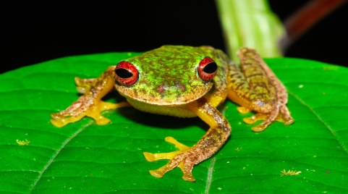
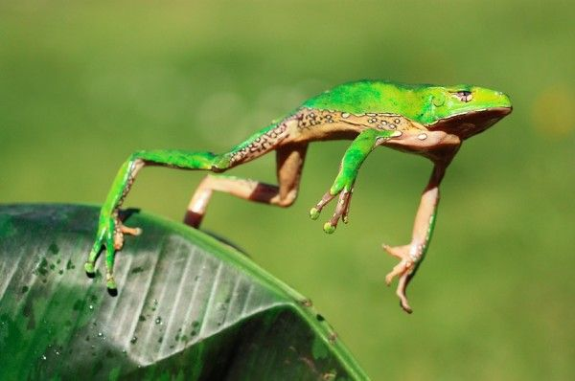
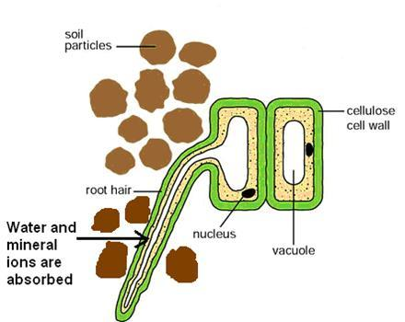
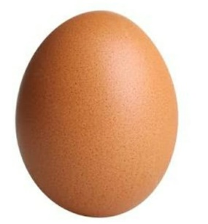
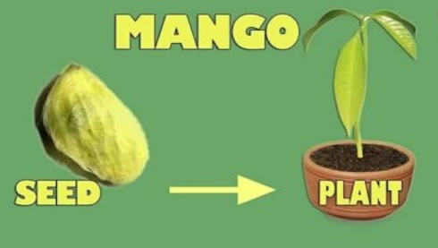
Meaning of Cell theory
Structural Unit
Functional Unit
Cells die and are replaced
All life starts as a single cell

Slide 5
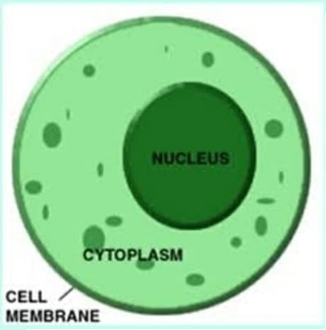
STRUCTURE OF A CELL
A generalised cell consists of three parts:
1. Cell membrane: Possess fine pores – substances may enter or leave; selectively semi-permeable in nature.
Cell wall in plant cell : Freely permeable.
2. Cytoplasm: Jelly like substance where cell organelles are embedded. All metabolic activities takes place. Seat of earlier steps of respiration.
3. Nucleus : Largest cell organelle protected by nuclear membrane.
Nuclear membrane have pores to allow substances to enter and leave the cell.
Contains network of thread like structure called chromatin fibres which contain DNA.

Slide 6
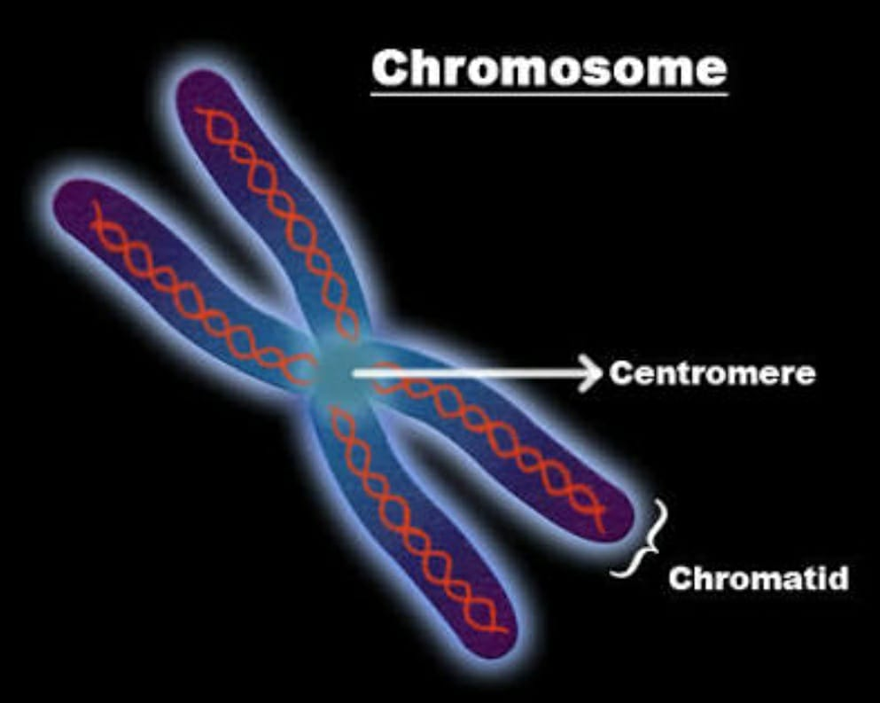
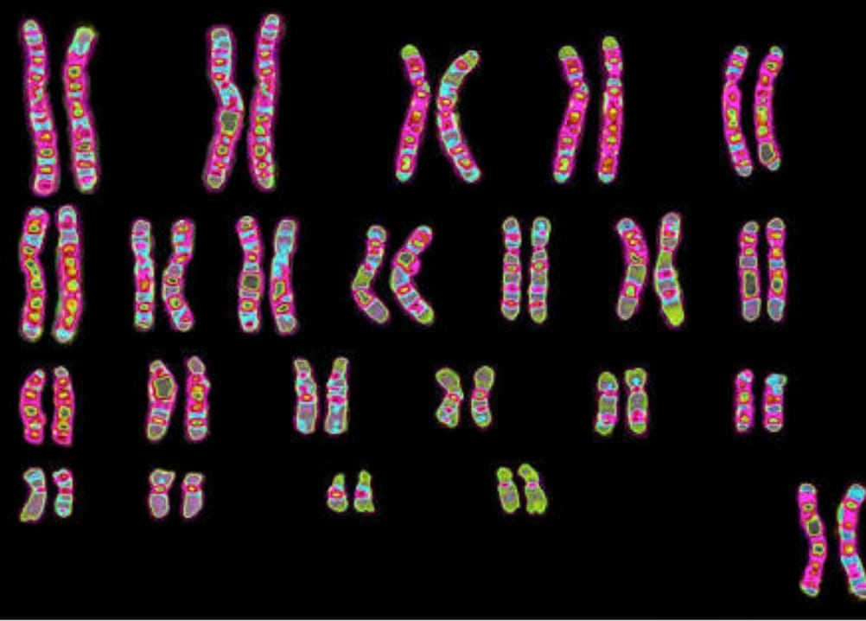
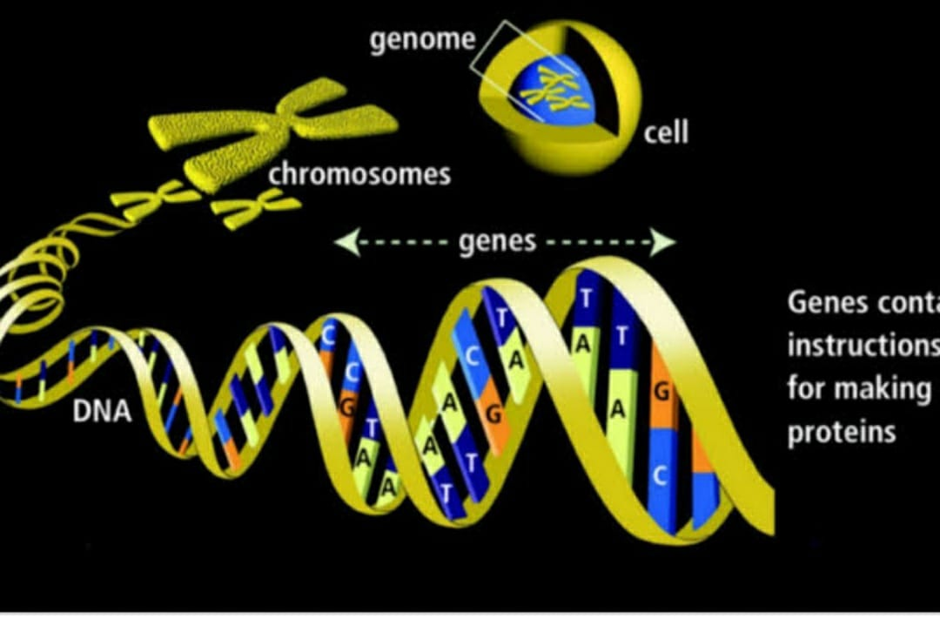
Number of Chromosomes
It is definite in each species.
Every human body cell has 46 chromosomes.
The chromosomes carry the genetic characters from parents to offspring during fertilisation.
Genes are the hereditary units and determine the characteristics of a species.
Genes are made up of DNA ( Deoxyribonucleic acid)

Slide 7
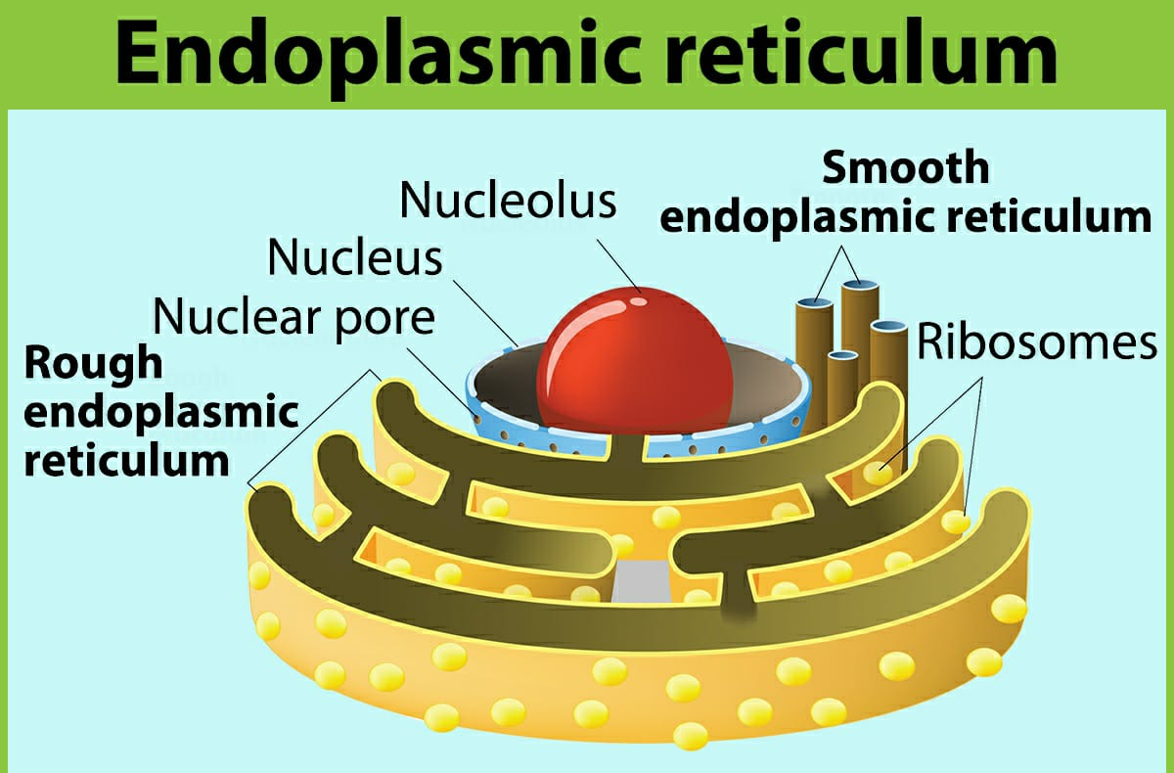
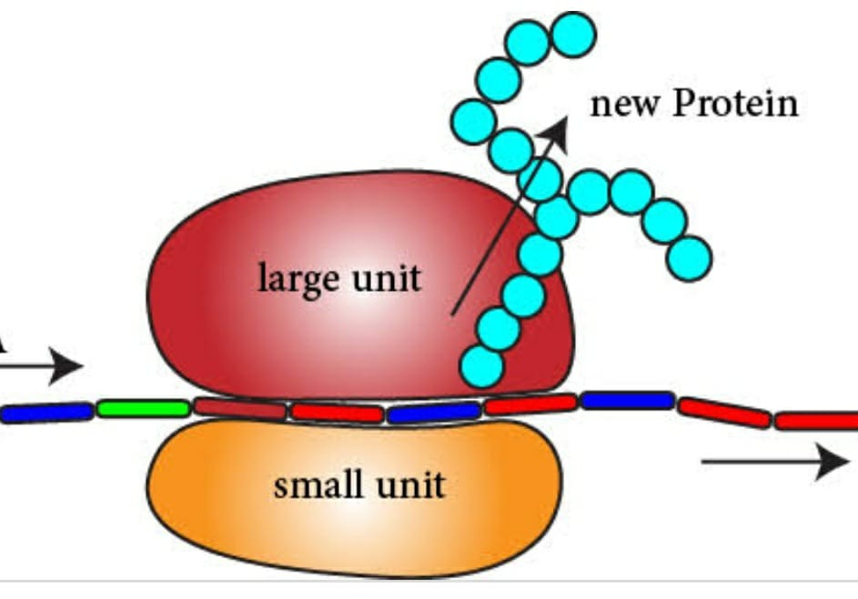
PART OF A CELL | MAIN CHARACTERISTICS | CHIEF FUNCTION
Endoplasmic reticulum | Irregular network with double membrane. Outer end connected with plasma membrane and inner end with nuclear membrane. Appears rough( ribosomes attached) smooth( without ribosomes) | Supporting framework Pathway for distribution of materials.
Ribosomes | Found scattered in cytoplasm or attached to ER | Synthesis of protein

Slide 8
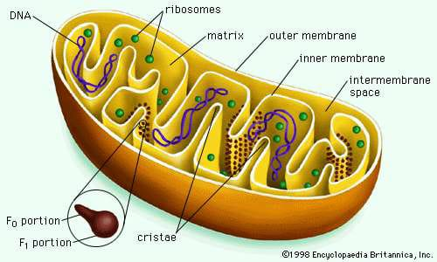
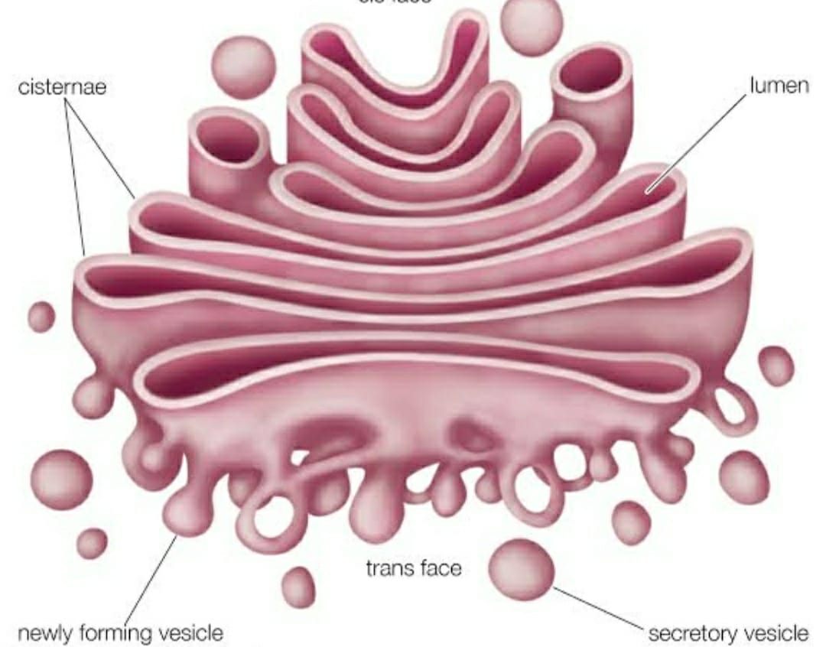
Mitochondria | Usually spherical/rod shape, double walled with inner walls thrown into fold called cristae. Have their own DNA and contain their own ribosomes. | Release of energy Synthesis of respiratory enzymes.
Golgi apparatus | Granules or filament shaped, originated from ER Consists of vesicles, vacuoles. | Synthesis and secretion of enzymes, hormones. Formation of acrosome of sperm

Slide 9
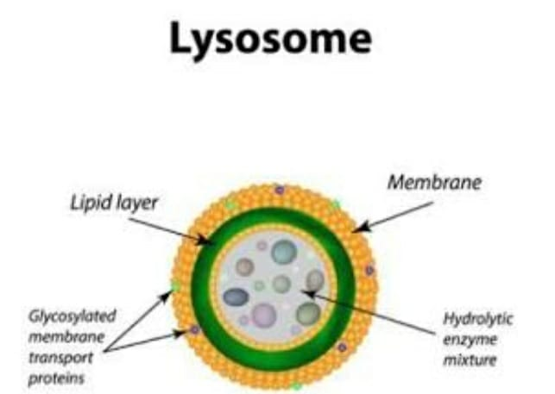
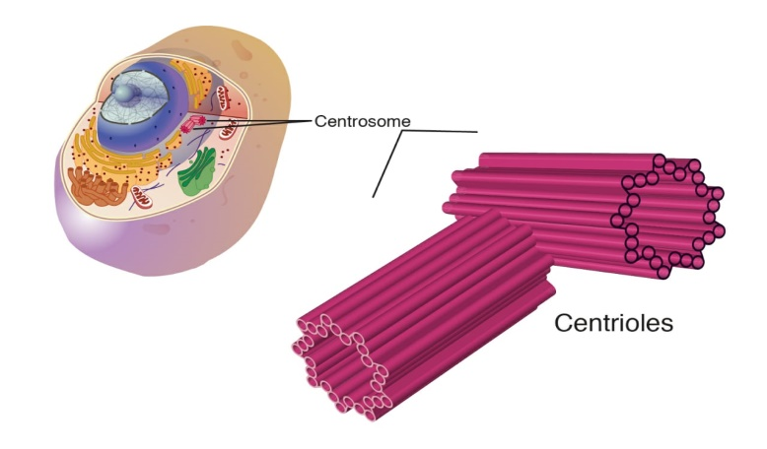
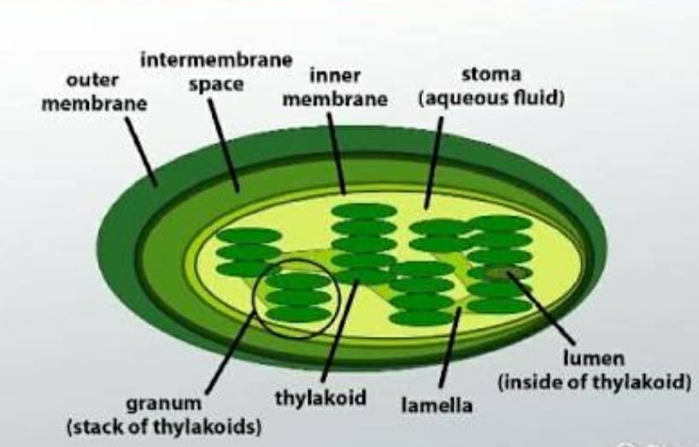
Lysosomes | Small vesicles of different shapes. Contains 40 different types of enzymes. | Destroy foreign substances Called as suicidal bags as they destroy old or damaged cells.
Centrosome and centrioles | Found only in animal cell, close to nucleus. Contains one or two centrioles. Surrounded by radiating microtubules to form a star | Initiates and regulates cell division. Forms spindle fibresduring cell division.
Plastids | Found only in plant cells. Several kinds but most common is Chloroplast containing green pigment chlorophyll. Double membrane, contain DNA. Disc like structure called thylakoids contain chlorophyll | Chromoplast imparts colour to flowers to fruits and flowers. Chloroplast traps solar energy for photosynthesis. Leucoplast stores starch. Anthocyanin pigment( blue, violet and purple) dissolved in the cell sap.

Slide 10
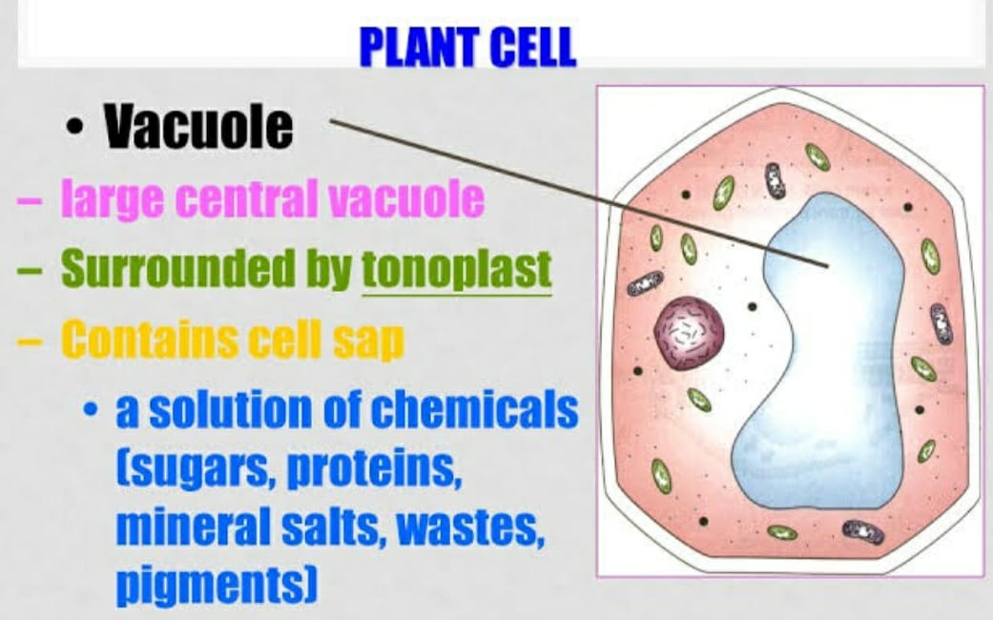
Non-living substances or Cell inclusions
Granules: They are small particles, crystals or droplets. They contain food materials such as starch, glycogen and fats.
Vacuoles:
Clear space in cytoplasm filled with water and various substances.
In plant cell vacuoles are large and filled with liquid -cell sap.
Animal cell has small and fewer vacuoles.

Slide 11
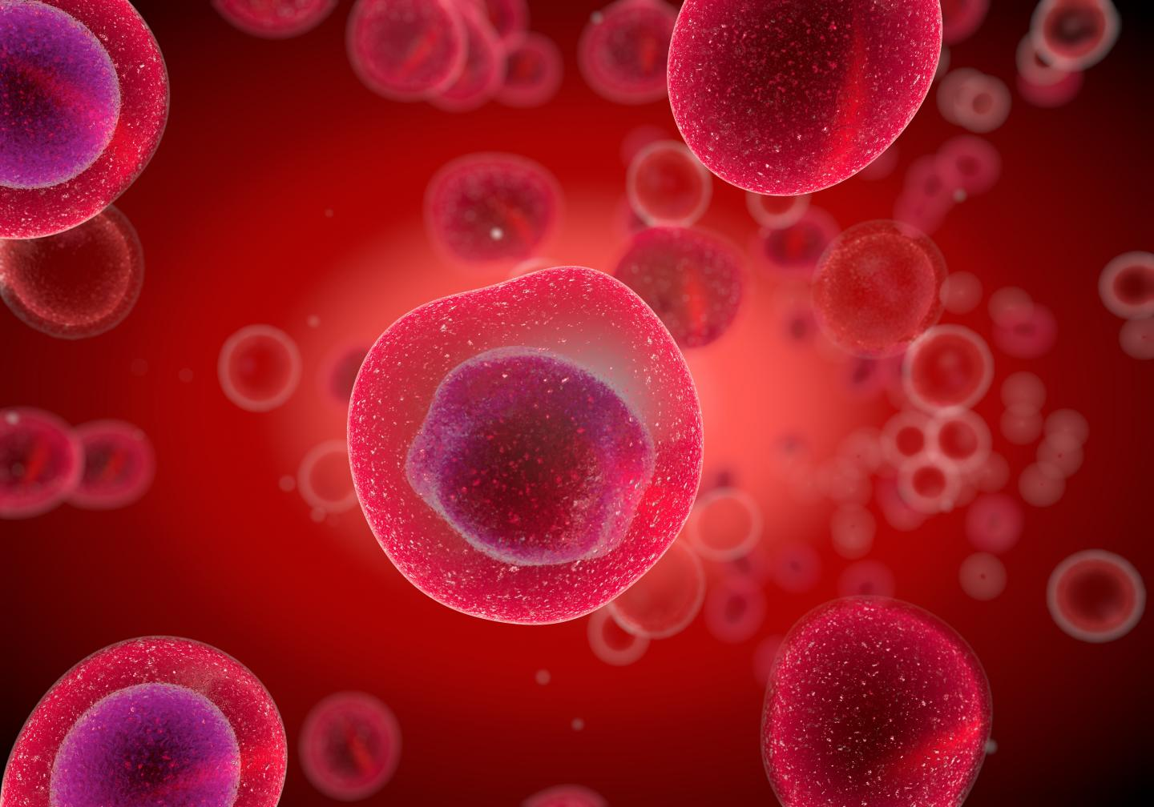
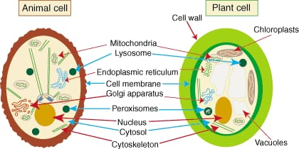
The plant cell and Animal cell
The basic structure of plant cell and animal cell is similar. Both contain the cell membrane, Endoplasmic reticulum, Golgi bodies, mitochondria and ribosomes.

Slide 12
Difference between plant cell and animal cell
Feature | Plant cells | Animal cells
Cell wall | Cell wall made up of cellulose | No cell wall
Centrosome | Centrosome not present | Centrosome present
Vacuoles | Vacuoles prominent | Vacuoles, if any, are small and temporary.
Plastids | Usually contain plastid | Do not contain plastids
Size | Usually larger, with distinct outlines | Usually smaller, with less distinct outline
Cytoplasm | Not so dense | Cytoplasm denser and more granules

Slide 13
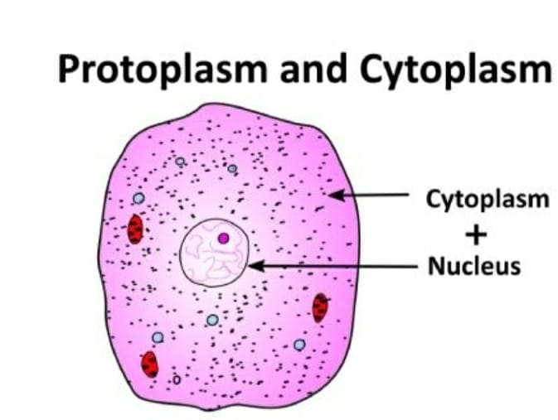
Protoplasm
Protoplasm is a translucent, greyish or brownish living substances in an organism i.e. the cytoplasm and the nucleus.
The chemical composition of protoplasm is very complex.
It is difficult to make an accurate analysis of protoplasm because it ceases to be protoplasm as soon as it is removed from the organism.

Slide 14
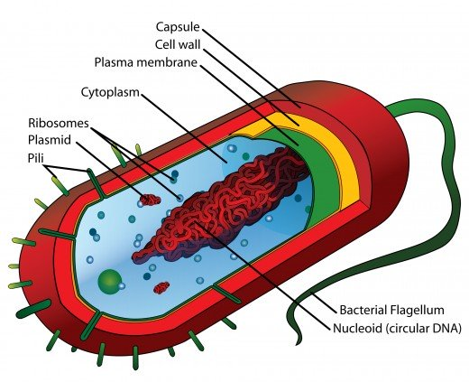
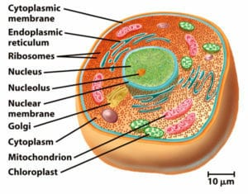
Prokaryotic and Eukaryotic cell
Prokaryotic cell refers to cells that do not have true nucleus or most other cell organelles. Bacteria have prokaryotic cells.
Eukaryotic cells have a nucleus surrounded by a nuclear membrane and membrane -bound organelles like mitochondria, golgi bodies etc.

Slide 15
Difference between Prokaryotic and Eukaryotic cells
PROKARYOTIC CELL | EUKARYOTIC CELL
No well defined nucleus | Well defined nucleus with a nuclear membrane
A single length of only DNA | Several lengths of chromosomes containing DNA wound around certain proteins
Small ribosomes | Larger ribosomes
No other cell organelles Examples: Bacteria, Blue green algae | Several organelles( mitochondria, ER, chloroplast etc) Examples: Euglena, Amoeba and all plants and animals.

